Slide 1
RNA-seq workflow and Experimental DESIGN
Vidhya Jagannathan
19.11.2018

Slide 2
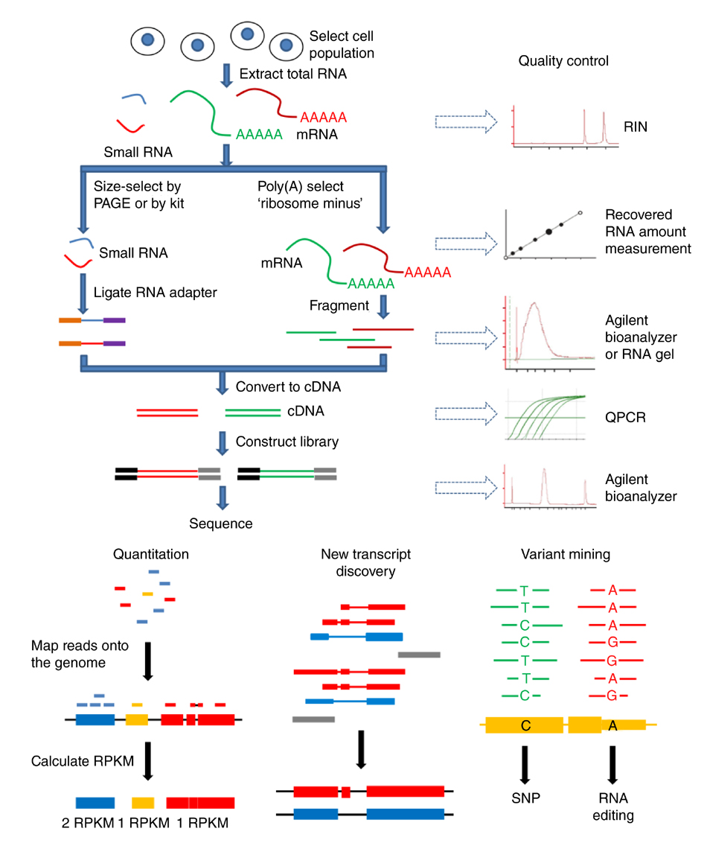
Notes:
(a) Schematic diagram of RNA-seq library construction. Total RNA is extracted from 300,000 cells to 3 million cells, and a small aliquot is used to measure the integrity of the RNA. rRNA is then depleted through one of several methods to enrich subpopulation of RNA molecules, such as mRNA or small RNA. mRNA is fragmented into a uniform size distribution and the fragment size can be monitored by RNA gel electrophoresis or Agilent Bioanalyzer. The cDNA is then built into a library. The size distribution pattern of the library can be checked by Agilent Bioanalyzer; this information is important for RNA-seq data analysis. (b) Mapping programs align reads to the reference genome and map splice junctions. Gene expression can be quantified as absolute read counts or normalized values such as RPKM. (c) If RNA-seq data sets are deep enough and the reads are long enough to map enough splice junctions, the mapped reads can be assembled into transcripts. (d) The sequences of the reads can be mined by comparing the transcriptome reads with the reference genome to identify nucleotide variants that are either genomic variants (for example, SNPs) or candidates for RNA editing.

Slide 3
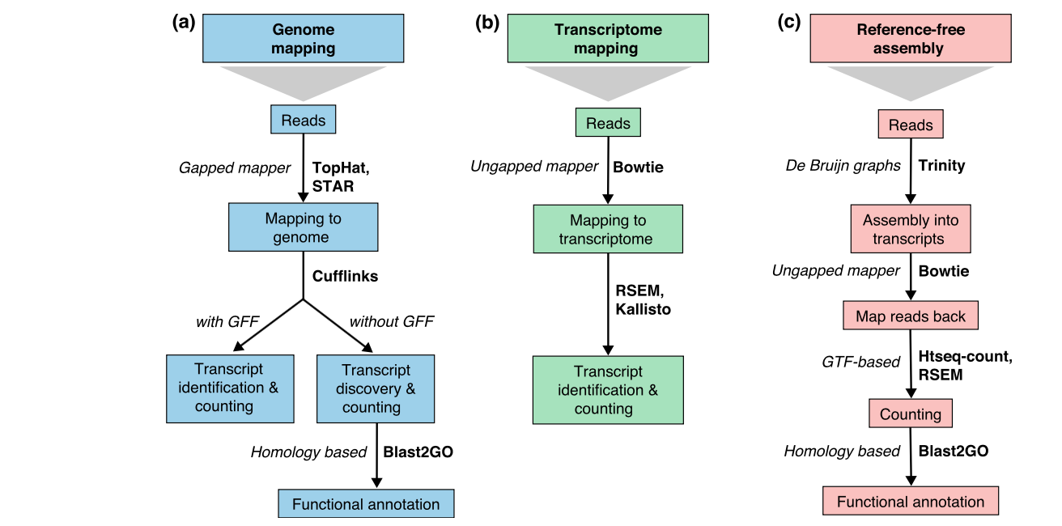
RNA-Seq Approaches
Genome Biology 2016,17:13

Slide 4
Bioinformatics Work flow
Raw reads
.fastq.gz
FASTQC
mapping
Tophat2/hisat2/STAR
RSEQC/QoRTs
Aligned reads
.sam/.bam
counting
HT-seq/featureCounts
Read Count Table
TMM, DESeq2, Cuffdiff 2
Normalizing
Descriptive plots
Normalized Count Table
edgeR, DESeq, DESeq2, Cuffdiff, Cuffdiff 2, and baySeq.
DE test and multiple testing
Descriptive plots
List of fold change and statistical values
Custom scripts
Downstream Analysis of DE genes
Notes:
Many of the normalization methods proposed in the literature are based on the correction of biases or artifacts directly related to the RNA-Seq technology, such as transcript lengths and sequencing depths, non-uniformity of read distributions along transcripts and strong sample-specific GC-content effect

Slide 5
Experimental Design
Replicates
Read Length and Depth
Library type
Notes:
For a successful RNA-seq experiment, the data generated should have the potential to answer the questions of interest. For this a good experimental design is required. Good experimental design means choosing the right library type, sequencing depth and number of replicates.

Slide 6
Why replicates
Technical Variability
between library construction
between flowcells (different runs)
between lanes
between sequencing platforms
Biological Variability
Sample variability
Factors of interest (treatment or disease or phenotypic groups)

Slide 7
Replicates
Technical replicates: not really useful if they are from the same library. Biases arise mostly in the library preparation step.
Technical replicates from different libraries from the same sample can used control the batch effects from reverse transcription and PCR amplification.
Biological replicates: more useful if you want to catch the source of technical and biological variability.
Can draw general conclusions from samples to population.
Two unrelated human are biological replicates or two batches of cell line are biological replicates ?
Encode 2011- consortium finally concluded replicates are 2 independently grown tissue/cell.

Slide 8
Summary of Marioni et al
Illumina RNA-seq shows good reproducibility and has advantages over microarray
Lane effect is small (?)
Large difference between runs (Batch effect)
Large difference between cDNA concentration
RNA-seq: an assessment of technical reproducibility and comparison with gene expression arrays
Genome Res. 2008 Sep;18(9):1509-17.

Slide 9
Summary of McIntyre et al. 2011
Technical variation exits:
Mappable reads per lane varies among technical replicates
Higher variability for those with low coverage (< 5 reads per nucleotide) or low expression level
Suggestion: Inclusion of technical replicates is as important as biological replicates. Multiplexing design can eliminate the lane effect for a small experiment.

Slide 10
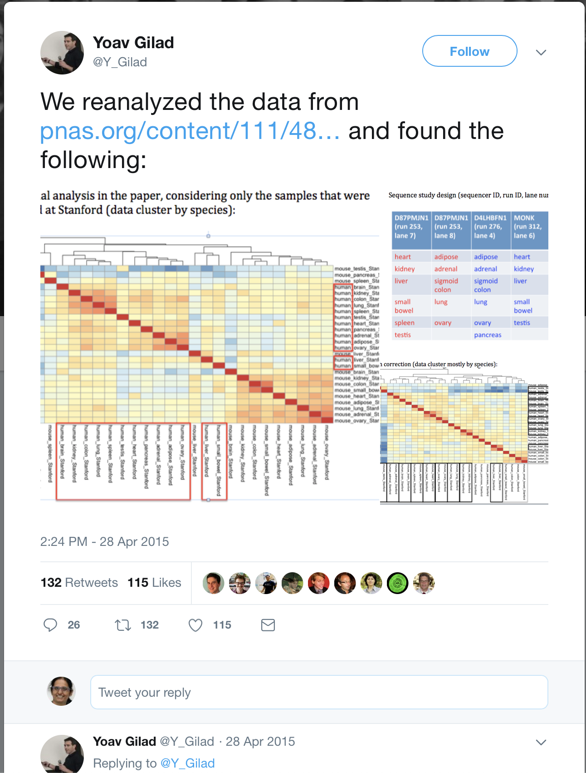
Batch effect example
Mouse ENCODE consortium reported in PNAS that, across a wide range of tissues, gene expression was more likely to follow a species-specific rather than tissue-specific pattern.
But latter Yoav Gilad of the University of Chicago called these results into question on Twitter.
With a dozen or so 140-character dispatches (including three heat maps), Gilad suggested the results published in PNAS were an anomaly—a result of how the tissue samples were sequenced in different batches.
If this “batch effect” was eliminated, he proposed, mouse and human tissues clustered in a tissue-specific manner, confirming previous results rather than supporting the conclusions reported by the Mouse ENCODE team.
Gilad Y and Mizrahi-Man O. A reanalysis of mouse ENCODE comparative gene expression data. F1000Research 2015, 4:121
Notes:
For example, genes in the mouse heart were expressed in a pattern more similar to that of other mouse tissues, such as the brain or liver, than the human heart.

Slide 11
Recent Benchmark Articles on Replicates and Depth
Three studies suggest that increasing number of biological replicates is more an efficient strategy than increasing library sizes
Power analysis and sample size estimation for RNA-Seq differential expression. RNA 20, 1684–1696
RNA-seq differential expression studies: more sequence or more replication? Bioinforma. Oxf. Engl. 30, 301–304
How many biological replicates are needed in an RNA-seq experiment and which differential expression tool should you use? RNA N. Y. N 22, 839–851
a library size of respectively 10 and 20 M reads per sample is the minimum threshold for an effective DE analysis
give more general recommendations based on their single data set study; they recommend at least six biological replicates per condition in general, and at least 12 replicates to identify the majority of DE genes.

Slide 12
Tools to estimate sample size
Scotty: a web tool for designing RNA-Seq experiments to measure differential gene expression. Bioinforma. Oxf. Engl. 29, 656–657.
Calculating sample size estimates for RNA sequencing data. J. Comput. Biol. J. Comput. Mol. Cell Biol. 20, 970–978
Sample size calculation based on exact test for assessing differential expression analysis in RNA-seq data. BMC Bioinformatics 14:357.
Power analysis and sample size estimation for RNA-Seq differential expression. RNA 20, 1684–1696
PROPER: comprehensive power evaluation for differential expression using RNA-seq. Bioinforma. Oxf. Engl. 31, 233–241.
Notes:
tools to estimate an optimal number of biological replicates per condition based on a pilot data set of the given experimental design or on the specification of desired coefficients of variation (CV) or dispersions of the future results

Slide 13
Read Length
Longer read length (150 vs 50bp)
Better ability to assemble unknown transcripts
Higher accuracy to map reads to complex regions (i.e repeats, gene families etc)
Splice junction detection is most affected by read length
Long reads provide minimal to no advantage for differential gene expression(??).
May be for quantifying transcript isoforms and gene families
The impact of read length on quantification of differentially expressed genes and splice junction detection
Genome Biol. 2015; 16(1): 131.

Slide 14
Sequencing Depth
Sequencing depth is an important consideration with RNA‐seq experiments.
a library size of respectively 10 and 20 M reads per sample is the minimum threshold for an effective DE analysis.
Wang et al. found a significant increase in correlation between gene transcripts observed and number of sequence reads generated when increasing sequencing depth from 1.6 to 10 million reads after which the gains plateau – 10 million reads detected about 80% of the annotated chicken transcripts.
Higher coverage of the genome is not as important as the quality of the input RNA-Seq data.
30-50M reads deeper transcript assembly or splicing.
A comparison across non-model animals suggests an optimal sequencing depth for de novotranscriptome assembly. BMC Genomics2013,14:167
Notes:
Sequencing depth is an important consideration with RNA‐seq experiments. Optimal sequencing depth depends on the aims of the experiment and on the complexity of the target transcriptome. Sequencing depth is usually referenced to be the expected mean coverage at all loci over the target sequence(s), in the case of RNA-seq experiments assuming all transcripts having similar levels of expression

Slide 15
Library Type
Single End
Paired End
Ins: 200-500 bp
Pair-end would help for:
Sequence alignment
Alternative splicing detection
Fusion gene detection
Single end sequencing is sufficient if the goal is only differential expression for known transcriptome.
SE reads recover junctions fairly well and that short reads are sufficient for unique mapping.

Slide 16
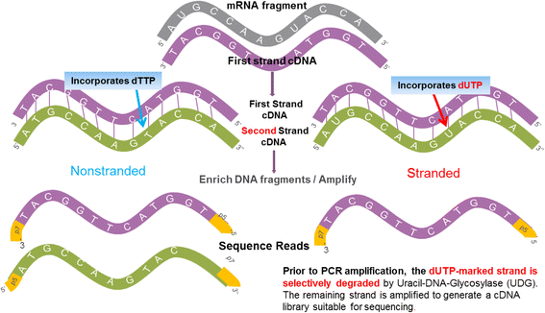
Directional (strand specific) sequencing
Illumina protocol utilizes different adapters ligated to 5’ and 3’ ends of RNA sequence.
Preserves orientation of RNA after reverse transcription
Can inform alignment to genome
Determine which genomic DNA strand is transcribed
Identify anti-sense transcripts
Demarcate coding sequences in microbes with overlapping genes.
Notes:
One class relies on attaching different adaptors in a known orientation relative to the 5′ and 3′ ends of the RNA transcript (Fig. 1a). These protocols generate a cDNA library flanked by two distinct adaptor sequences, marking the 5′ end and the 3′ end of the original mRNA. A second class of methods relies on marking one strand by chemical modification, either on the RNA itself by bisulfite treatment or during second-strand cDNA synthesis followed by degradation of the unmarked strand

Slide 17
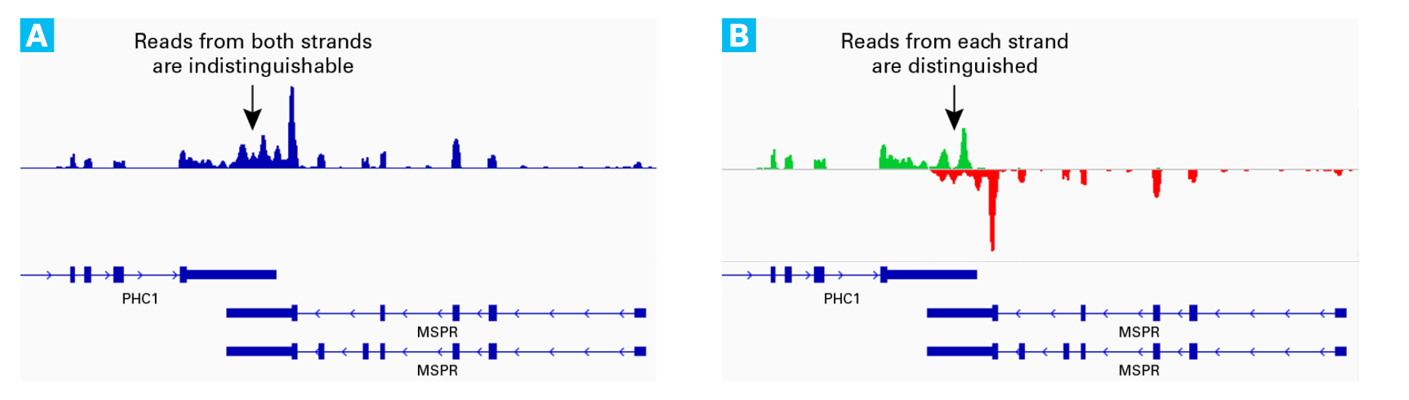
Stranded RNA
Comprehensive comparative analysis of strand-specific RNA sequencing methods. Nature Methods volume 7, pages 709–715 (2010)
Stranded RNA-seq provides a more accurate estimate of transcript expression compared with non-stranded RNA-seq, and is therefore the recommended RNA-seq approach for future mRNA-seq studies.
Comparison of stranded and non-stranded RNA-seq transcriptome profiling and investigation of gene overlap. BMC Genomics. 2015; 16(1): 675.

Slide 18
Summary
Technical variation exists and should be taken into account.
Lane effect, batch effect
Biological replicates minimum – 3 per group, 6 optimal, 12 better
Library type, read depth depends on the question to be answered.
Pilot experiment/tools to estimate sample size.

